Slide 1
Mobile based home automation using IoT and Prediction Algorithm

Slide 2
OVERVIEW
Problem Statement
Introduction
Algorithm
References

Slide 3
Problem Statement
To design a smart home automation system using a micro-controller based Arduino board and Android mobile app which uses a prediction algorithm to bring about next event recognition.

Slide 4
Introduction
Internet of Things(loT) deals with billions of intelligent objects which would be connected to sense & collect the data and also communicate with surrounding people using mobile, wireless and sensor technologies.
Main objective of loT is to manage and control physical objects around us in a more intelligent and meaningful manner.
We are using two prototypes namely home automation using Bluetooth in an indoor environment and home automation using Ethernet in an outdoor environment are presented, where we can turn ON or OFF the devices.
The app can also make smart or rational decisions and increase home
automation. This is done to maximize inhabitant comfort and minimize operation cost. A prediction algorithm is used for tracing and predicting the mobility patterns and usages of devices by the inhabitant

Slide 5
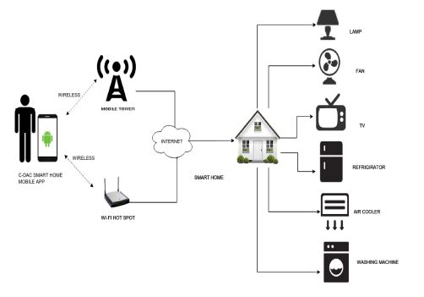
Introduction

Slide 6
Algorithm - LZ78 Algorithm
The LZ78 data compression is an incremental parsing algorithm based on the Markov model.
This algorithm has been interpreted as a Universal modeling scheme that sequentially calculates empirical probabilities in each context of the data; the generated probabilities reflect contexts seen from the beginning of the parsed sequence to the current symbol

Slide 7
Algorithm - LZ78 Algorithm
initialize dictionary := null
initialize phrase w := null
loop
wait for next symbol v
if ((w.v) in dictionary):
w := w.v
else
add (w.v) to dictionary
w := null
increment frequency for every
possible prefix of phrase
endif
forever

Slide 8
Algorithm - LZ78 Algorithm
Consider the sequence of input symbols nx =
“aaababbbbbaabccddcbaaaa”. An LZ78 parsing of this
string of input symbols as per above mentioned algorithm of LZ78 ,would yield the following set of phrases:
“a,aa,b,ab,bb,bba,abc,c,d,dc,ba,aaa”. The generated
dictionary is shown below. As described above, this
algorithm maintains statistics for all contexts seen within the phrases wi the setext statistics are stored in a trie.

Slide 9
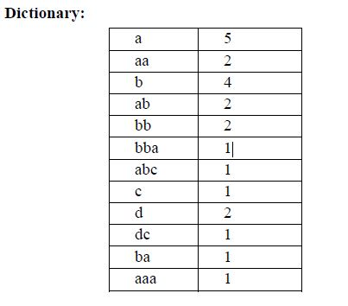
Algorithm - LZ78 Algorithm

Slide 10
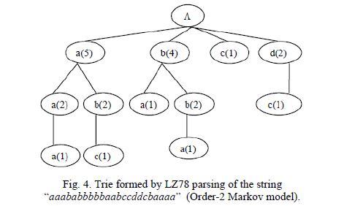
Algorithm - LZ78 Algorithm

Slide 11
Conclusion
a prototype smart horne automation using loT is presented. This research work will be carried forward by integrating relays to Arduino board for controlling home appliances from a remote location in a real scenario. As an extension, authors propose a generic loT framework and use cloud computing infrastructure for connecting and managing remote devices and also store sensor data. Authors plan to productize proposed horne automation solution so that more number of people can use loT in a smart environment.

Slide 12
References
Mobile based Horne Automation using Internet of Things(IoT), 2015 International Conference on Control,lnstrumentation, Communication and Computational Technologies (lCCICCT), Kumar Mandula, Ramu Parupalli, CH.A.S.Murty, E.Magesh, Rutul Lunagariya Centre for Development of Advanced Computing(C-DAC) ,A Scientific Society under Ministry of Communications and Information Technology, Government of India
Use of Prediction Algorithms in Smart Homes, International Journal of Machine Learning and Computing, Vol. 4, No. 2, April 2014, Aditi Dixit and Anjali Naik.
Online Sequential Prediction via Incremental Parsing: The Active LeZi Algorithm, Karthik Gopalratnam, University of Texas at Arlington ,Diane J. Cook, Washington State University

